Slide 1
Understanding Design System
By Rasmiranjan Nayak

Slide 2

Rasmiranjan Nayak
Technology Lead in Guavus, A Thales company
10+ years of experience as a full stack developer

Slide 3

Agenda
Overview of Design System
Why Design System?
Design System Elements
Design System - Workflow
Creating a Design System

Slide 4
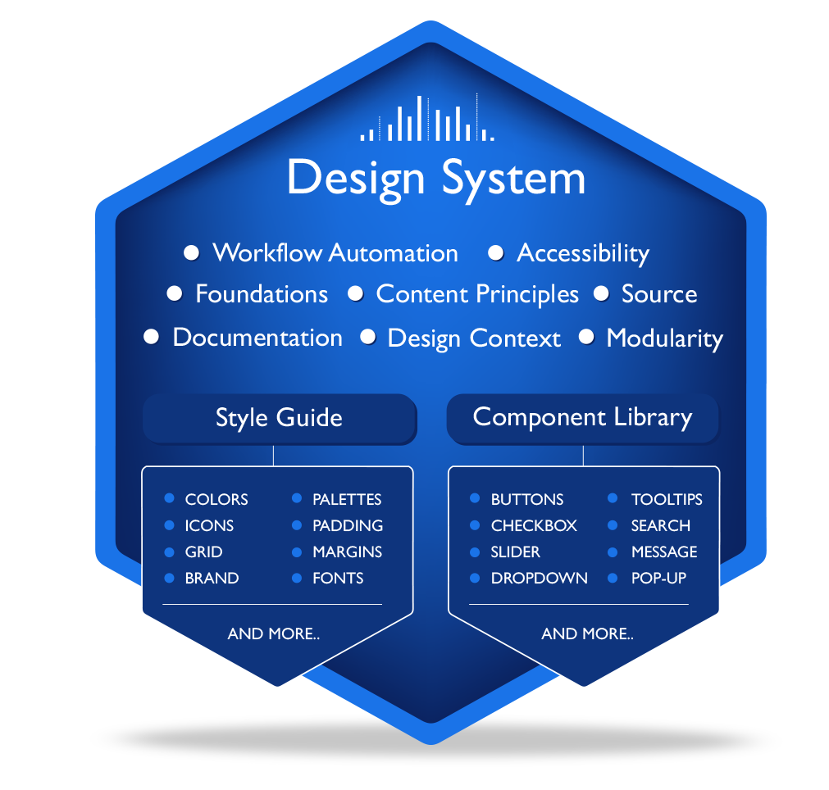
Design System
A design System is the single source of truth which groups all the elements that will allow the teams to design, realize and develop from prototype to full fledged products.

Slide 5

“ First, solve the problem.
Then, write the code”.
- John Johnson

Slide 6
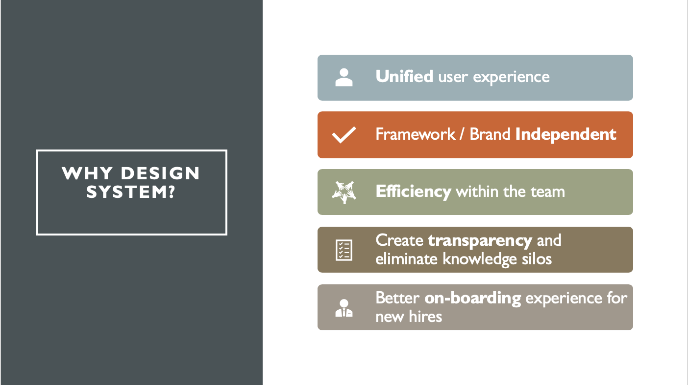

Slide 7

Top Design Systems
Google’s Material
Design
IBM’s Carbon
Design System
Shopify
Polaris
Atlassian Design
Guidelines
Apple Developer
Design Guidelines

Slide 8
Design System Ingredients

Slide 9

Design System
Design Elements
Principles
(Color, Typography, Icons,
Spacing, Elevations etc..)
(Style guide, Naming Convention,
Coding Standards, etc..)
Pattern Library
Documentations
(UI Components, Sketch
Symbols, etc..)
(Component Behavior, Implementation Guidelines, etc..)
Notes:
Lot of audit of existing products
Documentation plays a major role

Slide 10





Design Elements
Colors
Typography
Icons
Spacing
Elevation
Notes:
Icons, spacing, borders
Visualization colors

Slide 11
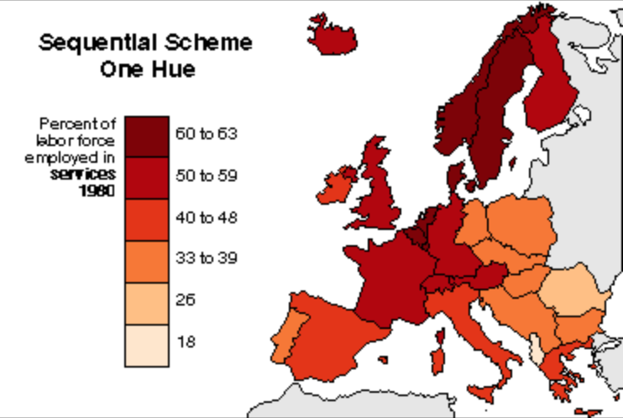
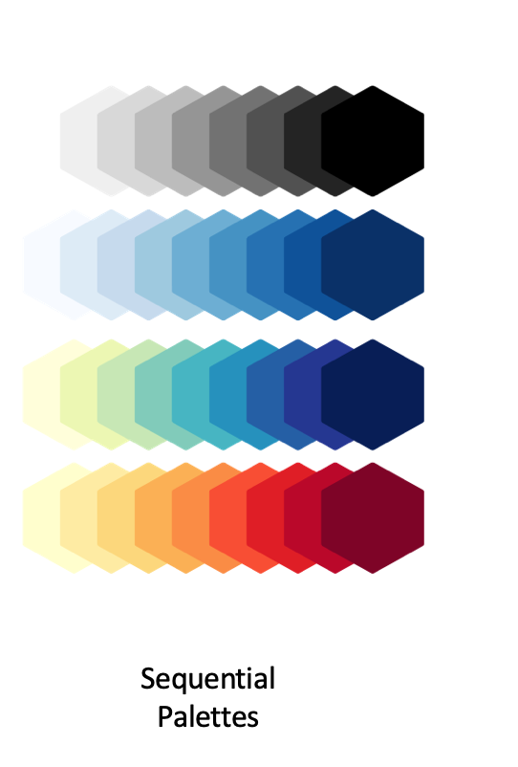
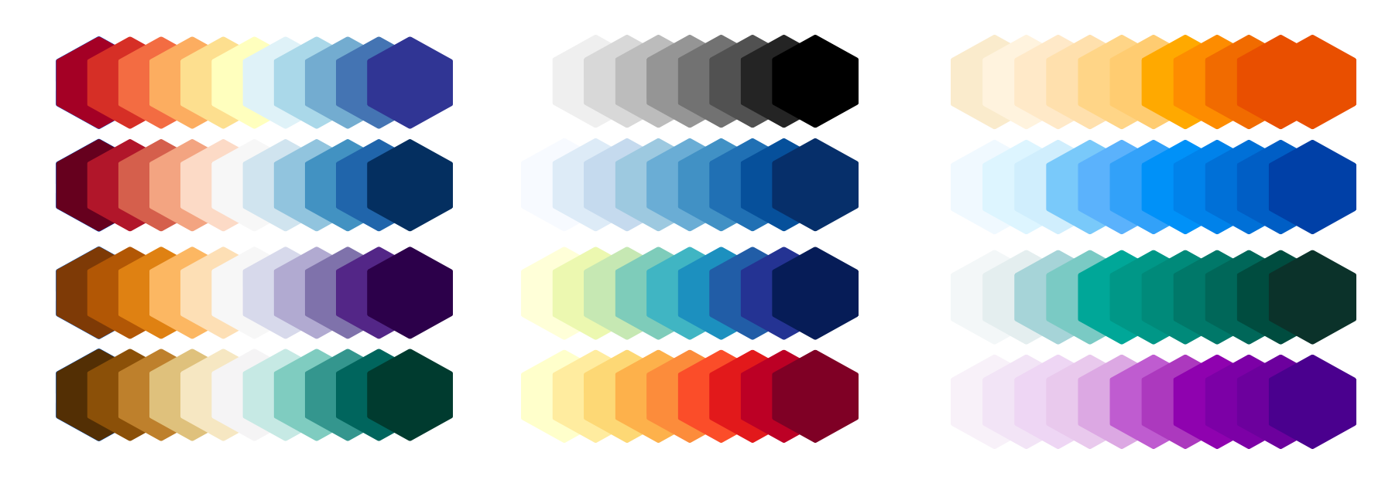
Visualization Colors
Diverging
Palettes
Sequential
Palettes
Contrasting
Palettes

Slide 12
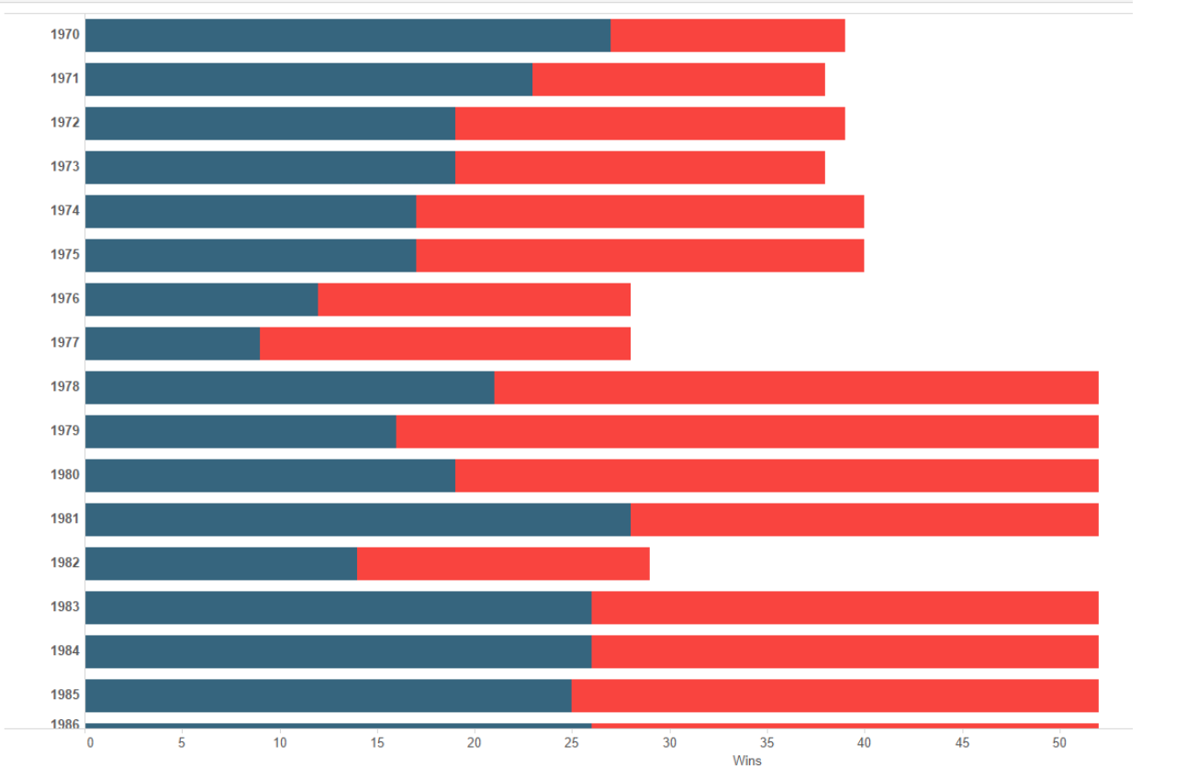
Visualization Colors
Diverging
Palettes
Sequential
Palettes
Contrasting
Palettes

Slide 13
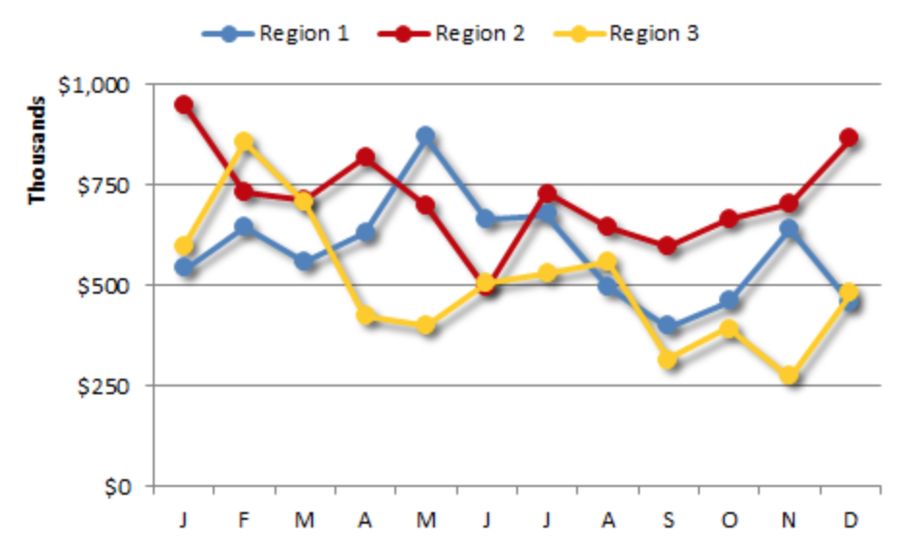
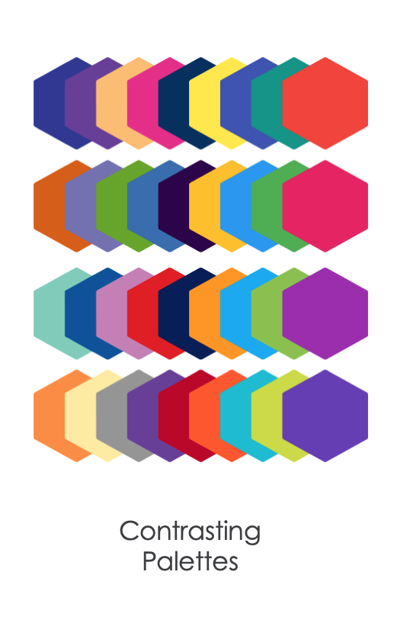
Visualization Colors
Diverging
Palettes
Sequential
Palettes
Contrasting
Palettes

Slide 14

Dynamic Theming
Dark
Theme
Light
Theme
XYZ
Theme

Slide 15
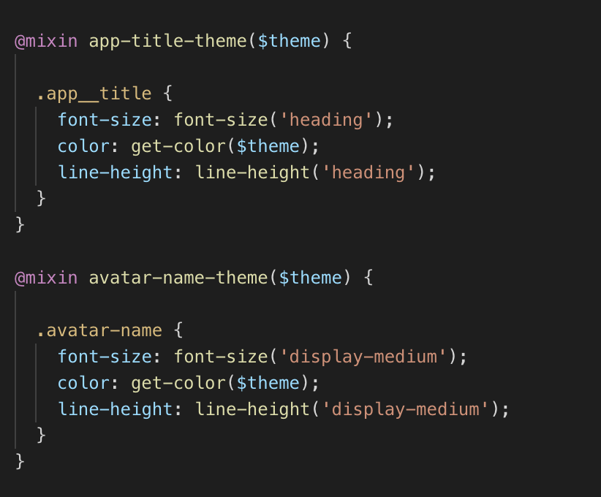
Principles
Style Guide
Naming Convention
Accessibility
Coding Standards

Slide 16

Pattern Library
UI Components
Design Symbols

Slide 17

Documentation
Component Behavior
Implementation Guideline
Update Process

Slide 18
Design System Process

Slide 19

Creating Components
Atoms
Molecules
Organisms
Templates
Pages
Notes:
3 minutes

Slide 20
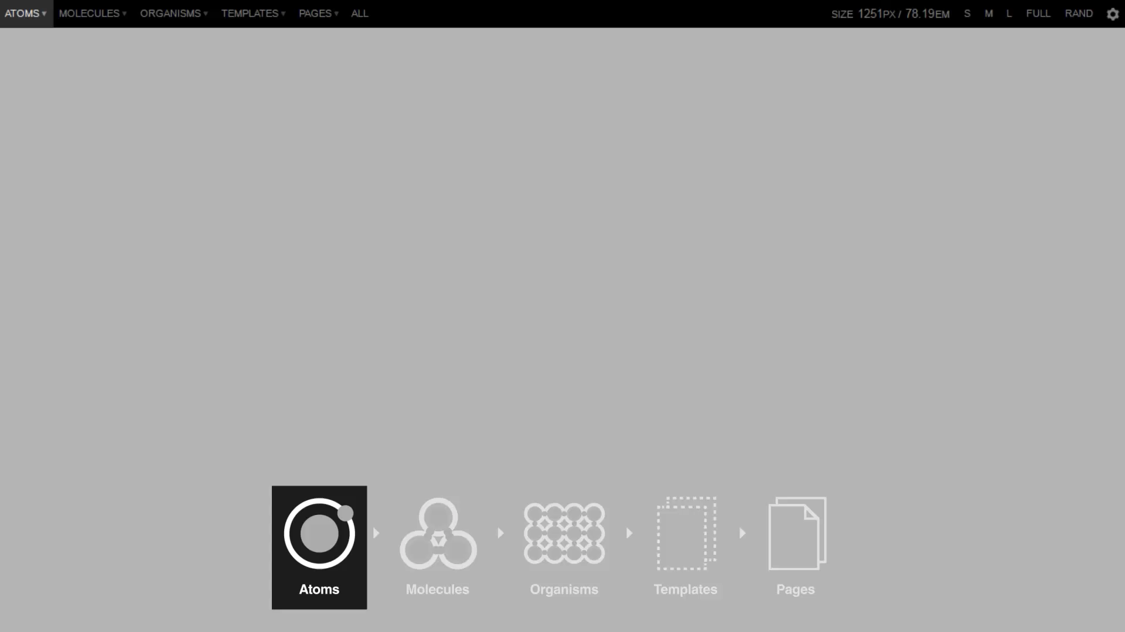

Slide 21
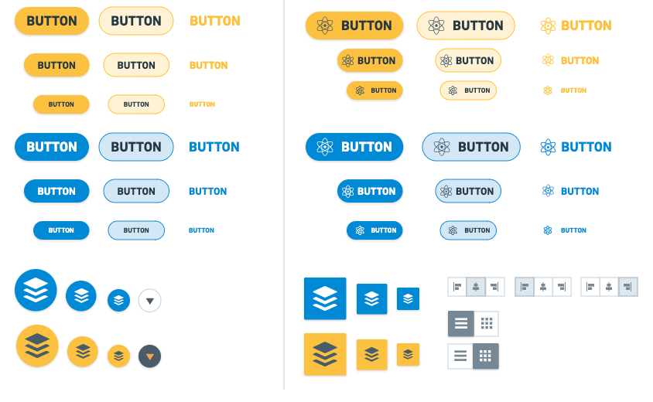
Button
Buttons are used primarily on action items. Some examples include Add, Save, Delete, Sign Up. Do not use Buttons as navigational elements. Instead, Use Links because it takes the user to a new page and is not associated with an action. Each page may have one to two primary buttons. Any remaining calls-to-action are represented as secondary buttons.
Notes:
Followed atomic design guideline

Slide 22
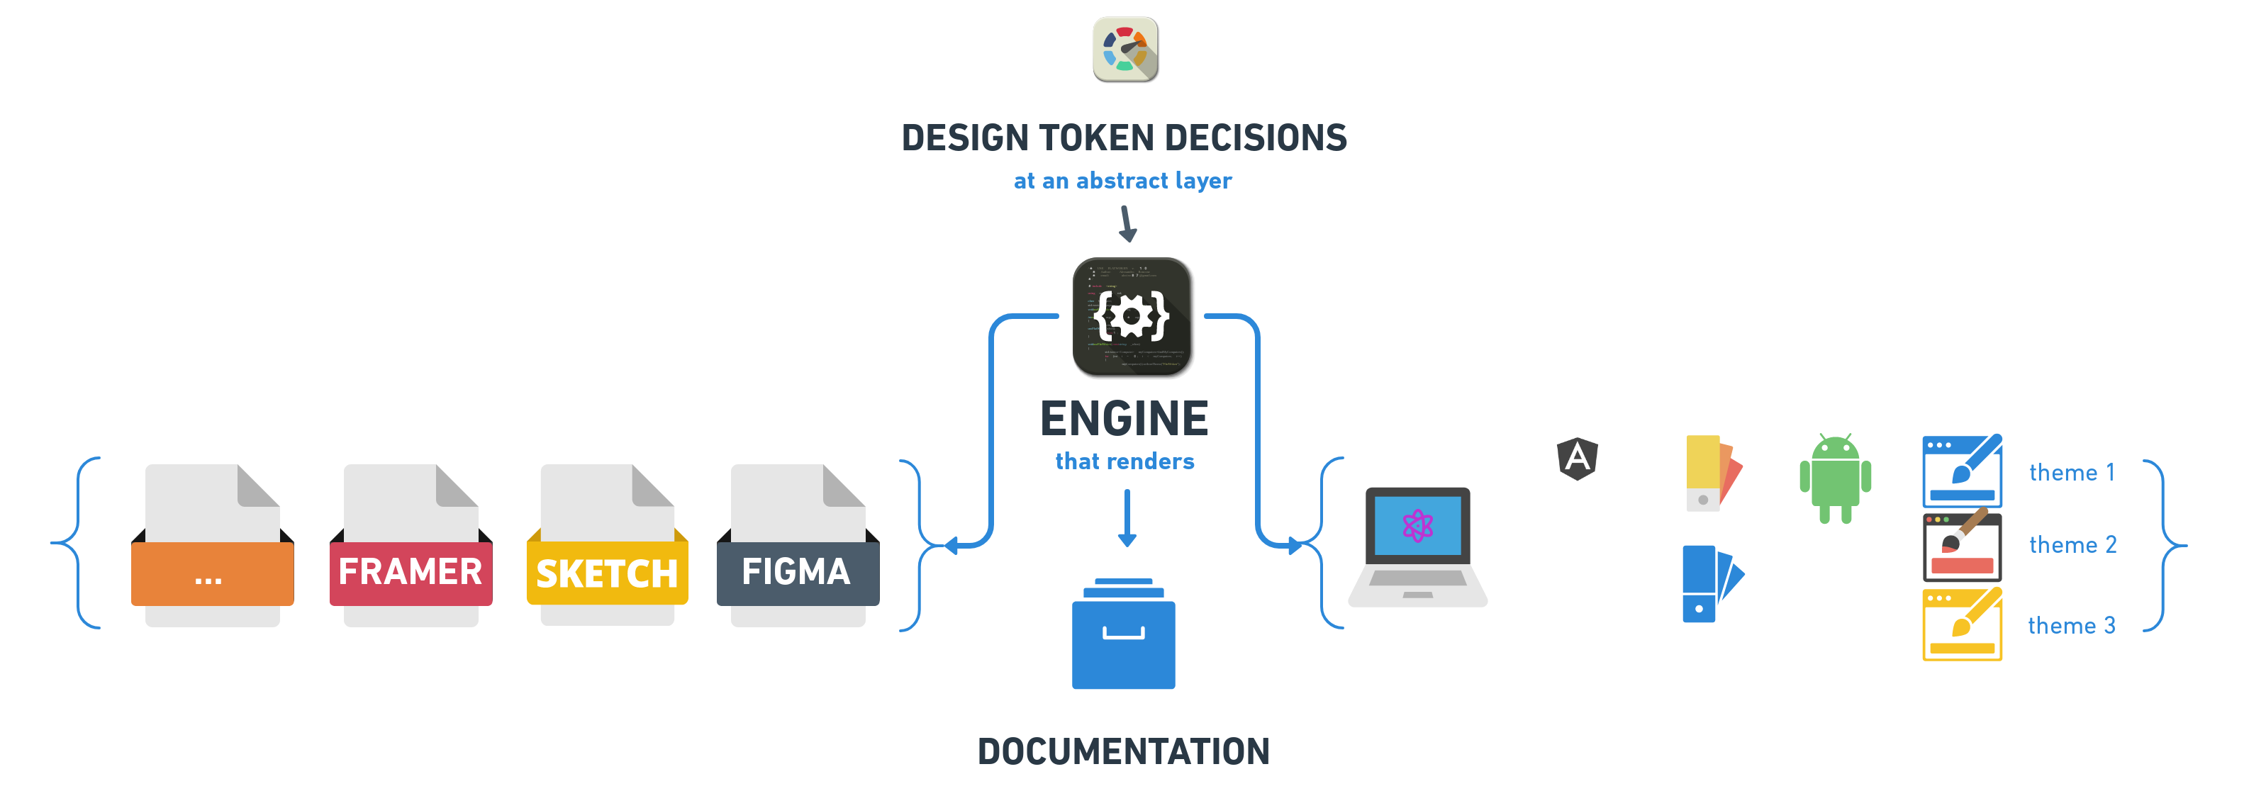
Design System Guidelines
Standard
Tools
Process

Slide 23
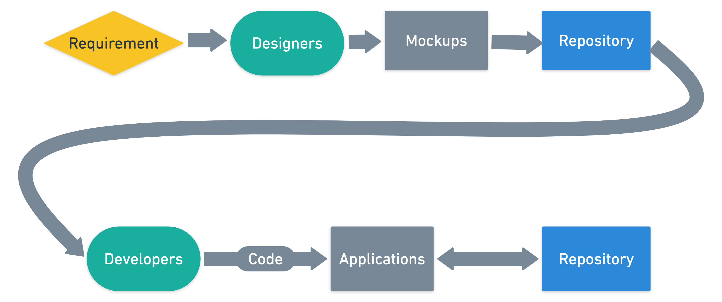
Traditional Flow
Notes:
Red lines shows design system flow
Gray line shows day to day work
Design system create once use multiple times.
All the problems we discussed in why design system it slide answers those.
Documentations are created as we progress. Its a shared responsibility between teams.

Slide 24
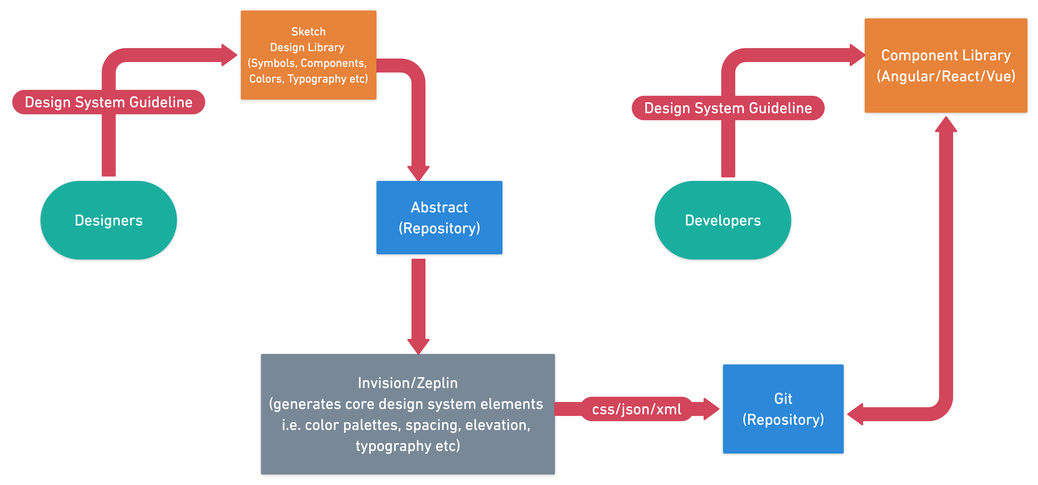
Design System flow
Notes:
Red lines shows design system flow
Gray line shows day to day work
Design system create once use multiple times.
All the problems we discussed in why design system it slide answers those.
Documentations are created as we progress. Its a shared responsibility between teams.

Slide 25
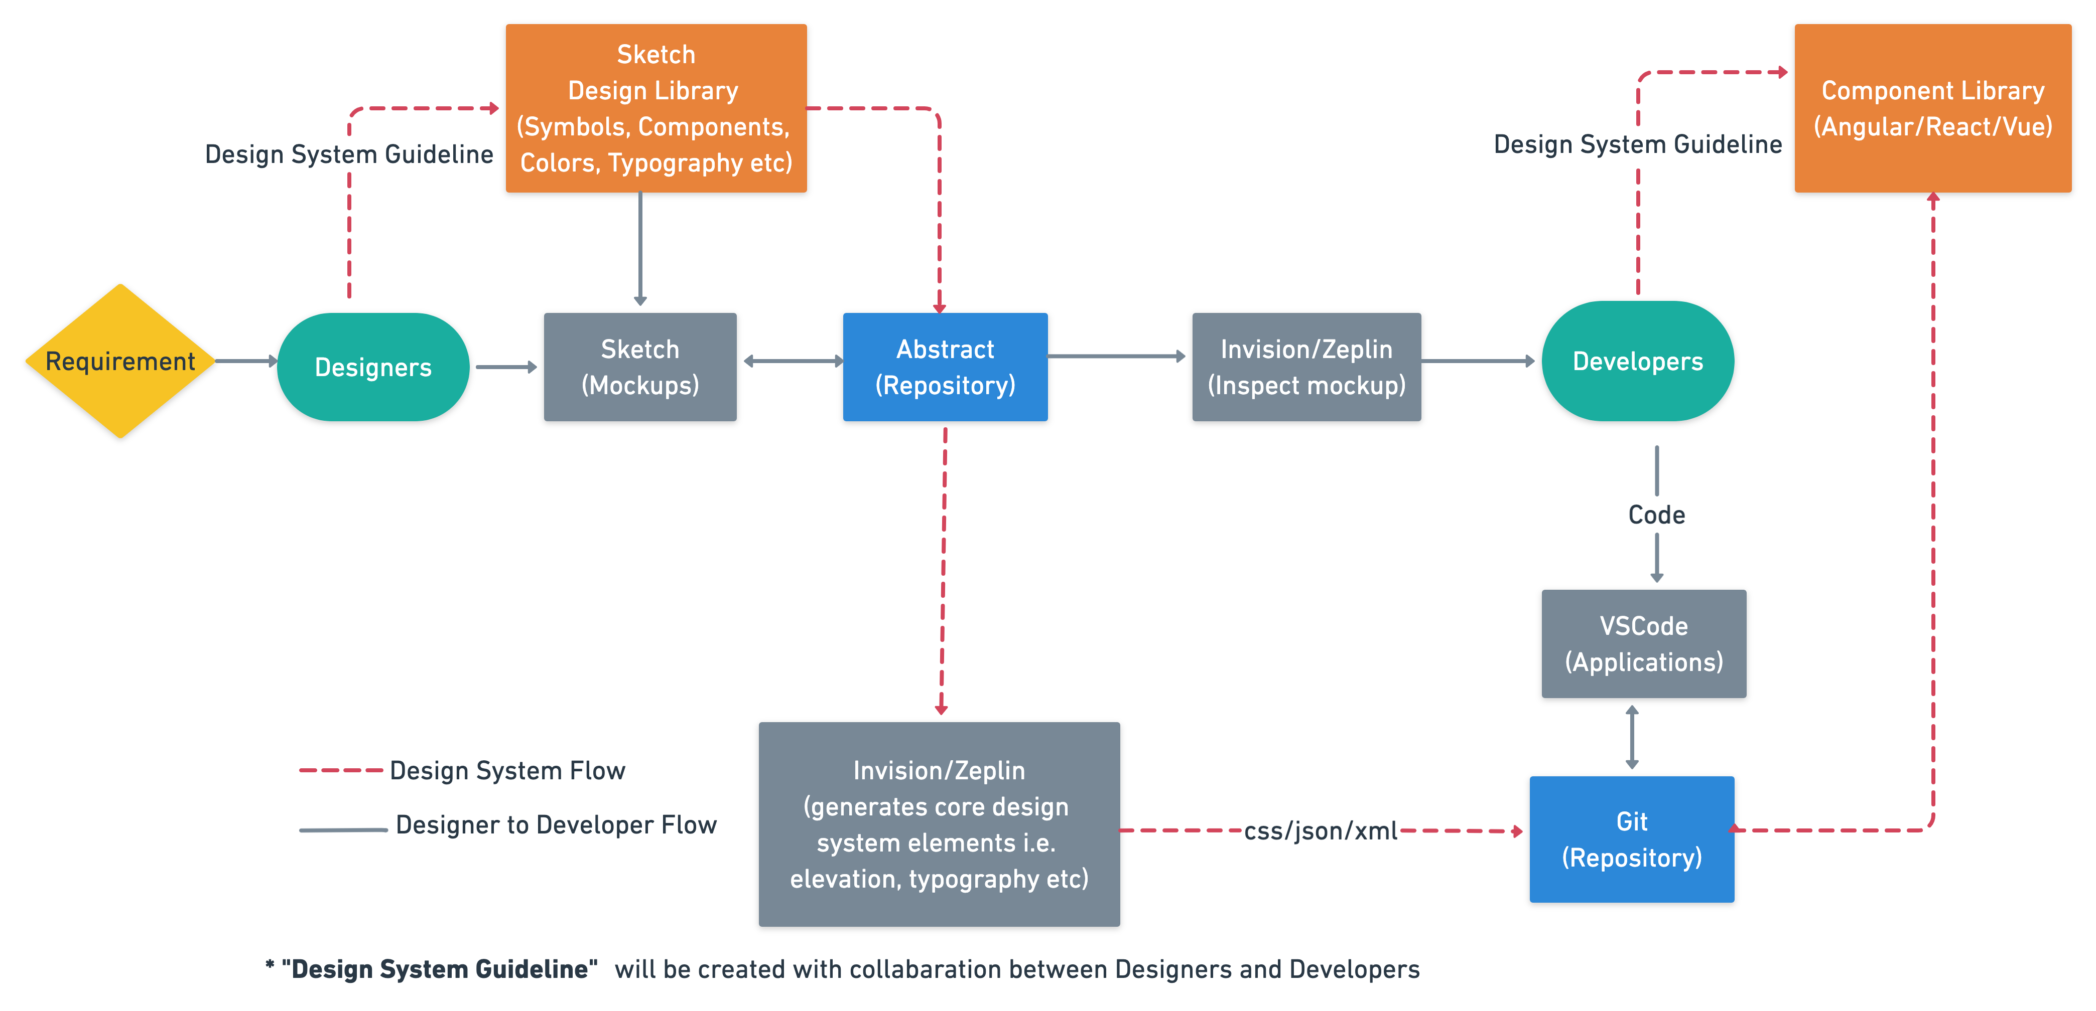
Work flow
Notes:
Red lines shows design system flow
Gray line shows day to day work
Design system create once use multiple times.
All the problems we discussed in why design system it slide answers those.
Documentations are created as we progress. Its a shared responsibility between teams.

Slide 26
Creating a Design System in your company

Slide 27

Creating a Design System
Discover
Define
Develop
Deliver
Basic research
Competitive analysis
User research
Interpretation session
Wireframes
Elements
Personas
Journey maps
Code,
Symbols
Output mockup
Final Code

Slide 28
“Design system is a continuous evolving process, not a methodology”

Slide 29
“Thinking about Design is hard, but not thinking about it can be disastrous”

Slide 30
Thank you
Lets Connect:
Guavus, A Thales company
Rasmiranjan.Nayak@thalesgroup.com
https://twitter.com/RushmeNayak
https://www.linkedin.com/in/rasmiranjan-nayak-10b61824/

Slide 31
Questions?

